Slide 1
Laptop Price Predictor
Team Members:
Deepak 2210990249
Devansh Aggarwal 2210990258
Devansh Bhagania 2210990259
Devansh Shandilya 2210990261
Devanshu Singh 2210990263
Faculty Coordinator:
Dr KD Singh
Chitkara University Institute of Engineering and Technology,
Chitkara University, Punjab

Slide 2
Contents
Problem Statement
Objective
Technical Details
Data Description
Dataset Snippets
Result and Analysis
Conclusion
References

Slide 3
Problem Statement
Problem Statement:- In this Tech driven world with the rapid advancement in technology and the frequent release of new models, predicting laptop prices has become a challenging task for both consumers and retailers.
Solution :- We decided to tackle this problem head-on by leveraging the power of Artificial Intelligence and Machine Learning ”

Slide 4
Objective
Create a comprehensive predictive model to estimate laptop prices, employing various regression techniques.
Assess the accuracy and reliability of the regression model in forecasting laptop prices through rigorous testing and validation.
Investigate how various laptop specifications, such as memory size, CPU type, brand, and other features, influence the overall price of the laptop.

Slide 5



Technical Details
We utilized Python as the primary programming language for the development of our regression model to predict laptop prices.
Our preferred IDE for this project was Jupyter Notebook, which facilitated efficient coding, visualization, and overall model development.
We leveraged several powerful Python libraries, including Pandas for data manipulation, Numpy for numerical computations, Matplotlib and Seaborn for data visualization, and Sklearn for implementing various regression algorithms.

Slide 6
Data Description
The dataset contains detailed information on laptops, including attributes such as memory, RAM, brand, screen resolution, weight, price, and more. It consists of 1083 rows and 12 columns.
The preprocessing steps included cleaning the dataset, handling missing values, encoding categorical variables, and scaling numerical features to ensure data consistency and enhance model performance.
Comprehensive exploratory data analysis was performed to understand the distribution, relationships, and patterns within the dataset. These insights guided the feature engineering and model development processes.

Slide 7
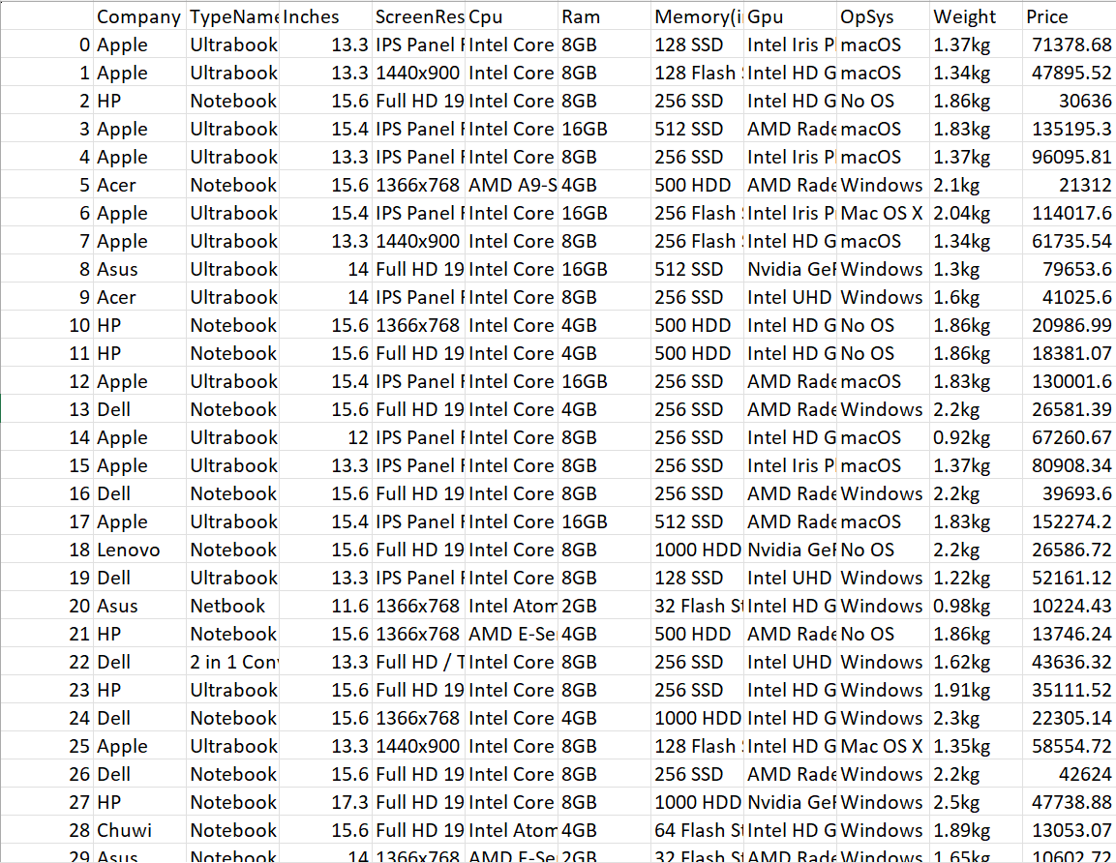
DATASET SNIPPETS

Slide 8
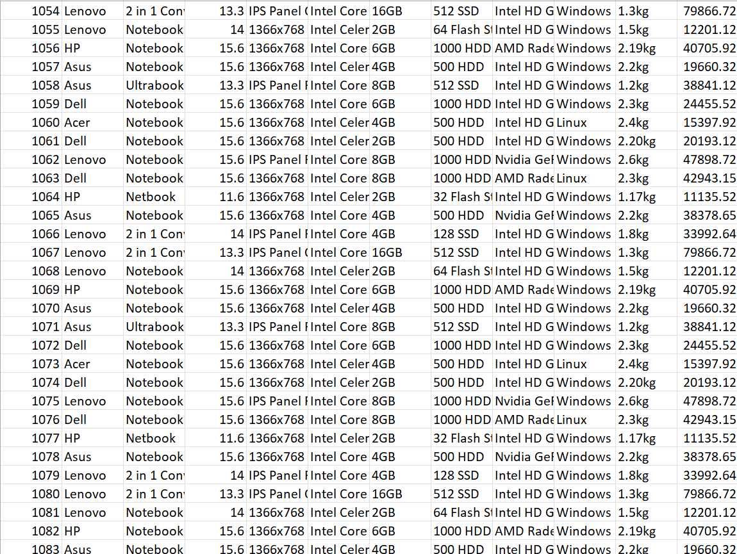
DATASET SNIPPETS

Slide 9
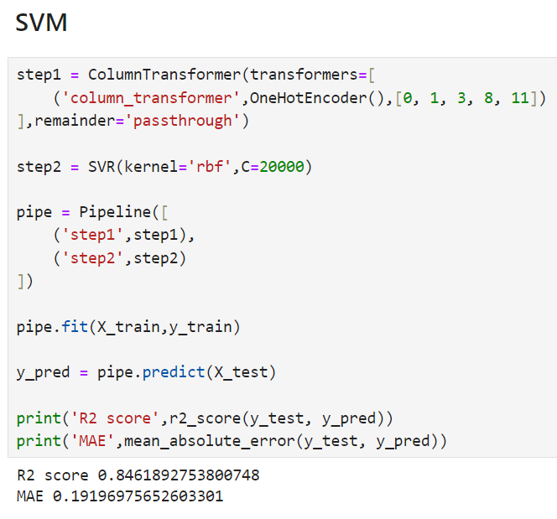
Result and Analysis

Slide 10
Conclusion
Key Findings: The project successfully developed a model that accurately predicts laptop prices.
Impact: The model provides valuable insights into the dynamics of laptop pricing and the factors influencing these prices, enabling buyers and retailers to make more informed decisions and strategic plans.
Future Prospects: Expanding the dataset and incorporating additional features will further enhance the model's accuracy and predictive power.

Slide 11
References
https://youtu.be/BgpM2IiCH6k?si=pSou189NV0LTTko3
https://scikit-learn.org/stable/
https://www.w3schools.com/python/python_ml_multiple_regression.asp

Slide 12
Thank You

